Slide 1
VQA using Deep Learning
By: Abhishek , Vignesh and yaksh

Slide 2
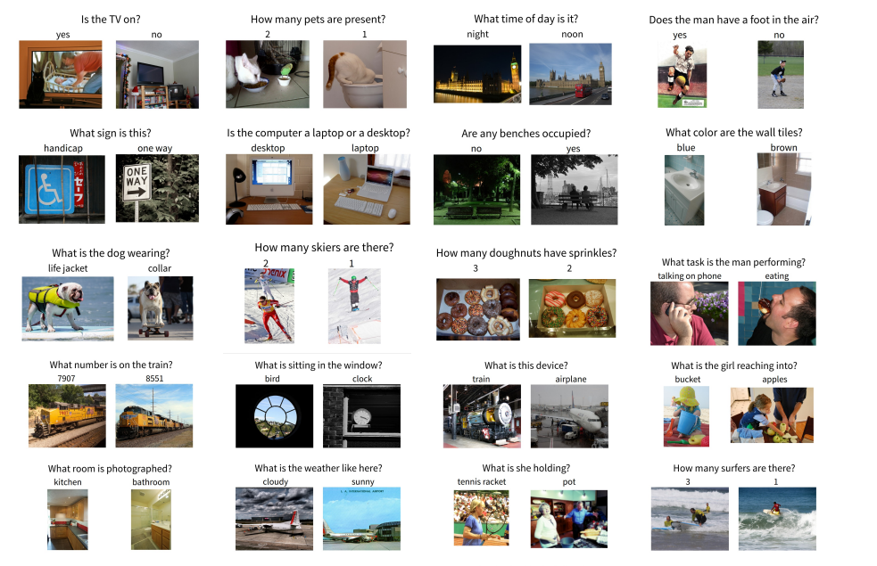
Dataset
VQA Dataset

Slide 3
Tokenized Input Question
Input Image
BERT Uncased Model
Resnet 50
Question Embedding
Image Encoding
Multi-Head Attention
Answer Generation

Slide 4
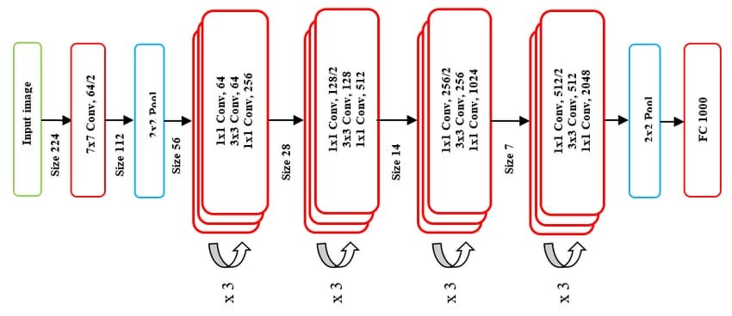
Image Decoder Architecture
Resnet 50 Architecture

Slide 5
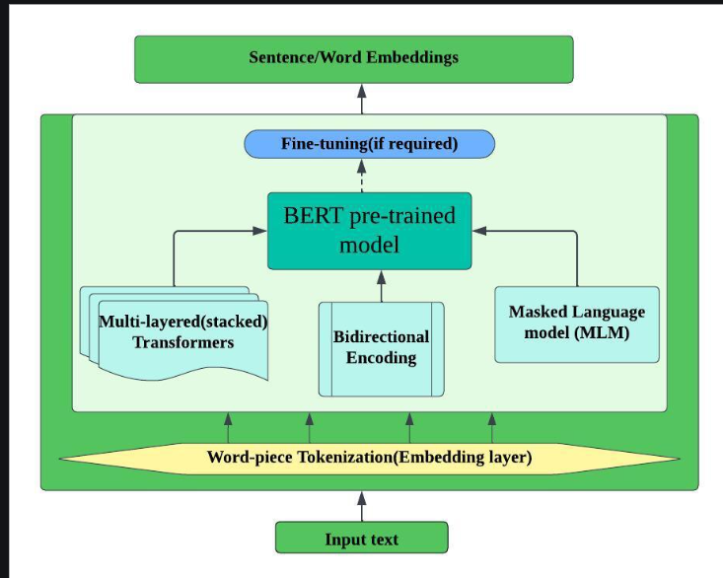
Text Decoder Architecture

Slide 6
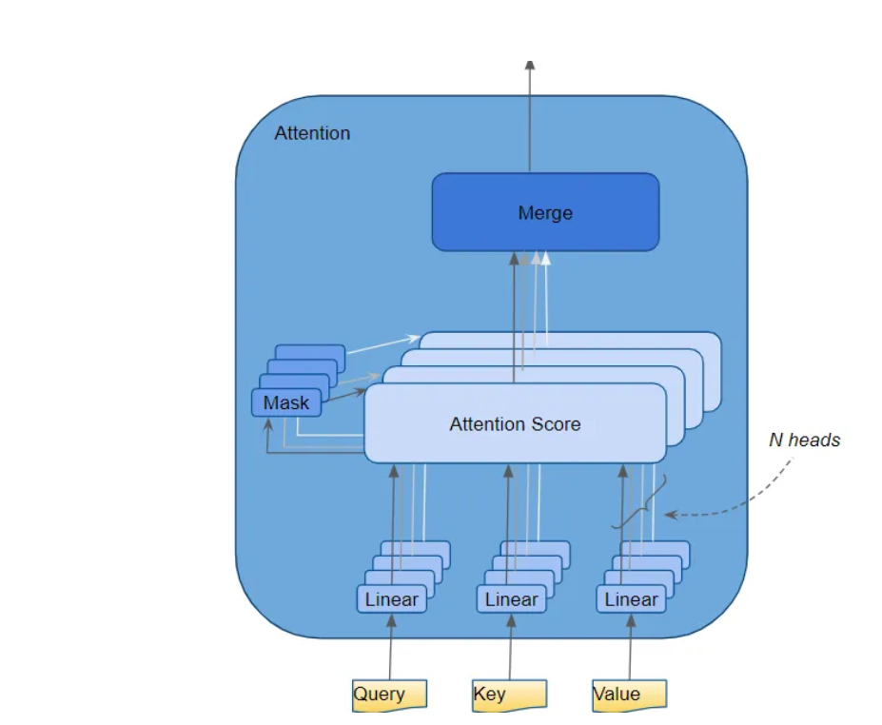
Multihead Attention

Slide 7
Our Approach
1. Text Encoding
- Model Used: BERT (Uncased).
- Tokenize the question and pass it through a pretrained BERT model (`bert-base-uncased`) for generating meaningful embeddings.
- Extract the `[CLS]` token embedding as the text feature vector.

Slide 8
Our Approach
2. Image Encoding
- Model Used: ResNet-50
- Removed the fully connected classification layer to use only feature extraction layers.
- The final feature extraction layer gives us the image feature vector.
- Output: A feature vector of size `[batch_size, 2048]`.

Slide 9
Our Approach
3. Feature Combination
- Project the text and image embeddings to a common dimensional space.
- Use Multihead Attention to model the interaction between the two modalities:
- Query: Text features + Image Features (Combined Features)
- Keys/Values: Text features + Image Features (Combined Features)
- Output: Attention-enhanced combined embeddings.

Slide 10
Our Approach
4. Answer Prediction
- Steps:
- Pass the combined features through fully connected layers.
- Used a Softmax layer to generate probabilities over the vocabulary of top 1000 answers
- Select the word with the highest probability as the predicted answer.
5. Cross Entropy Loss Function
- Used it for calculating the loss and validation purpose.

Slide 11
Limitations:
Bias towards a few certain classes.
Heavy load on computation because of the dataset size.
Unable to interpret complex tasks.

Slide 12
Probable solutions:
Training our model with a greater number of classes step by step eg 1200, 1500, 2000.
Using different attention mechanisms like cross attention, skip attention.
Using more powerful pre trained models for text/ image tokenization.
Building a better UI for customers to have an interactive experience of what is happening behind the scenes.

Slide 13
Model Evaluation

Slide 14
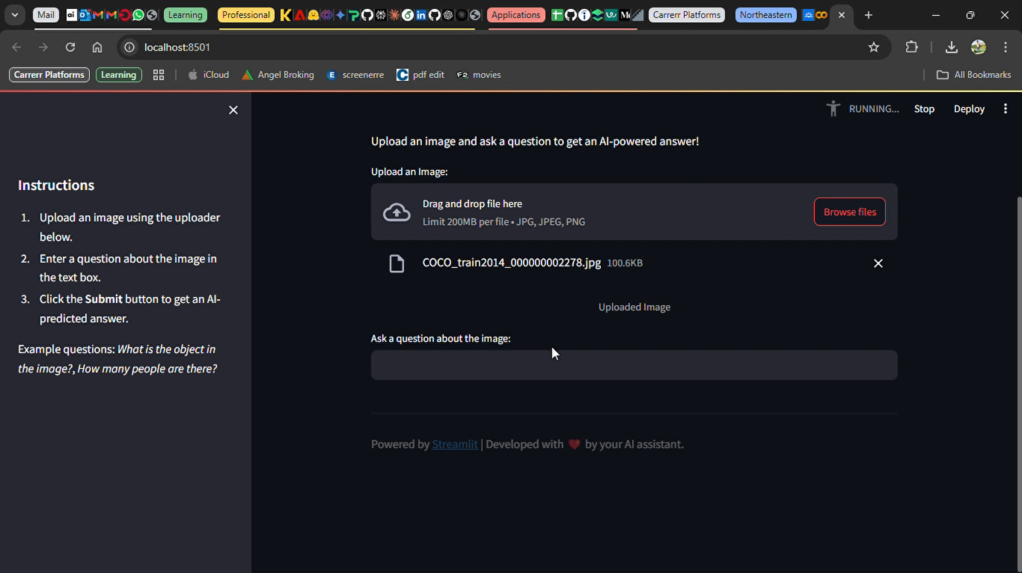
Project Demo

